Slide 1
CANCER DETECTION

Slide 2
What is Tumour
What Is a Tumor?
A tumor is an abnormal lump or growth of cells. When the cells in the tumor are normal, it is benign.
Something just went wrong, and they overgrew and produced a lump. When the cells are abnormal and can grow uncontrollably, they are cancerous cells, and the tumor is malignant.
To determine whether a tumor is benign or cancerous, a doctor can take a sample of the cells with a biopsy procedure. Then the biopsy is analyzed under a microscope by a pathologist, a doctor specializing in laboratory science.

Slide 3
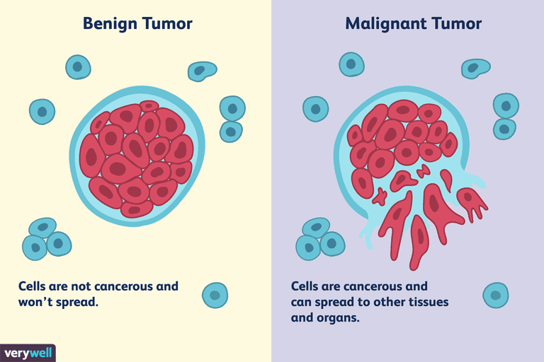

Slide 4
2. Malignant Tumors: Cancerous
Malignant means that the tumor is made of cancer cells and it can invade nearby tissues.
Some cancer cells can move into the bloodstream or lymph nodes, where they can spread to other tissues within the body—this is called metastatis . Cancer can occur anywhere in the body including the breast, intestines ,lungs, reproductive organs, blood, and skin.
For example, breast cancer begins in the breast tissue and may spread to lymph nodes in the armpit if it's not caught early enough and treated. Once breast cancer has spread to the lymph nodes, the cancer cells can travel to other areas of the body, like the liver or bones. The breast cancer cells can then form tumors in those locations. A biopsy of these tumors might show characteristics of the original breast cancer tumor.

Slide 5
Differences Between Benign and Malignant Tumors
There are many important differences between benign and malignant tumors. Some of these include:
Growth rate: Malignant tumors may grow more rapidly than benign tumors, although there are slow-growing and fast-growing tumors in either category.
Ability to invade locally: Malignant tumors may invade the tissue around them. One of the most prominent hallmarks of cancer is penetration of the basal membrane that surrounds normal tissues.
Ability to spread at distance: Malignant tumors spread to other parts of the body using the bloodstream or the lymphatic system. Malignant tumors may also invade nearby tissues and send out fingers into them, while benign tumors don't. Benign tumors only grow in the place where they started.
Recurrence: Benign tumors are easier to remove by surgery as they have clearer boundaries, and as a result, they are less likely to recur. If they do recur, it is only at the original site. Malignant tumors may have spread. As a result, they are more likely to recur and may recur in other sites, such as breast cancer recurring in the lungs or bones.
Cellular appearance: When a pathologist looks at tumor cells under a microscope, it is often obvious whether they are normal, benign cells or cancerous cells. Cancer cells often have abnormal chromosomes and DNA, making their nuclei larger and darker. They also often have different shapes than normal cells. However, sometimes the difference is subtle.
Systemic effects: While there are some benign tumors that secrete hormones, such as benign , pheochromocytmous malignant tumors are more likely to do so. Malignant tumors can secrete substances that cause effects throughout the body, such as fatigue and weight loss. This is known as paraneoplastic syndrome.
Treatments: A benign tumor can usually be completely treated with surgery, although some may be treated with radiation therapy or medication. Some benign tumors are not treated as they are not posing any health risk. Malignant tumors may require chemotherapy, radiation therapy, or immuneotherapy medications to eliminate cells that may be remaining or may have spread to other parts of the body.

Slide 6
Can a Benign Tumor Turn Malignant?
Some types of benign tumors only very rarely transform into malignant tumors. But some types, such adenomatous polyps (adenomous) in the colon have a greater risk of transforming into cancer. That is why polyps, which are benign, are removed during colonoscopy. Removing them is one way of preventing colon cancer.
It's not always clear-cut whether a tumor is benign or malignant, and your doctor may use several different factors to diagnose it as one or the other. You may end up with an uncertain diagnosis. Also, it is possible that a biopsy finds precancerous cells or misses the area where the cancerous cells are more prevalent. In these cases, what was thought to be benign might turn out to be malignant as it further grows and develops.

Slide 7
What Your Tumor Diagnosis Means
If you have been diagnosed with a malignant tumor, your oncologists (cancer doctor) will devise a treatment plan with you based on the stage of cancer. Early-stage cancers haven't spread much, if at all, whereas later-stage cancers have spread to more areas of the body. Determining the stage of cancer may require biopsies, surgery, and/or imaging tests. Once the cancer stage is determined, you can proceed with therapy.

